Slide 1
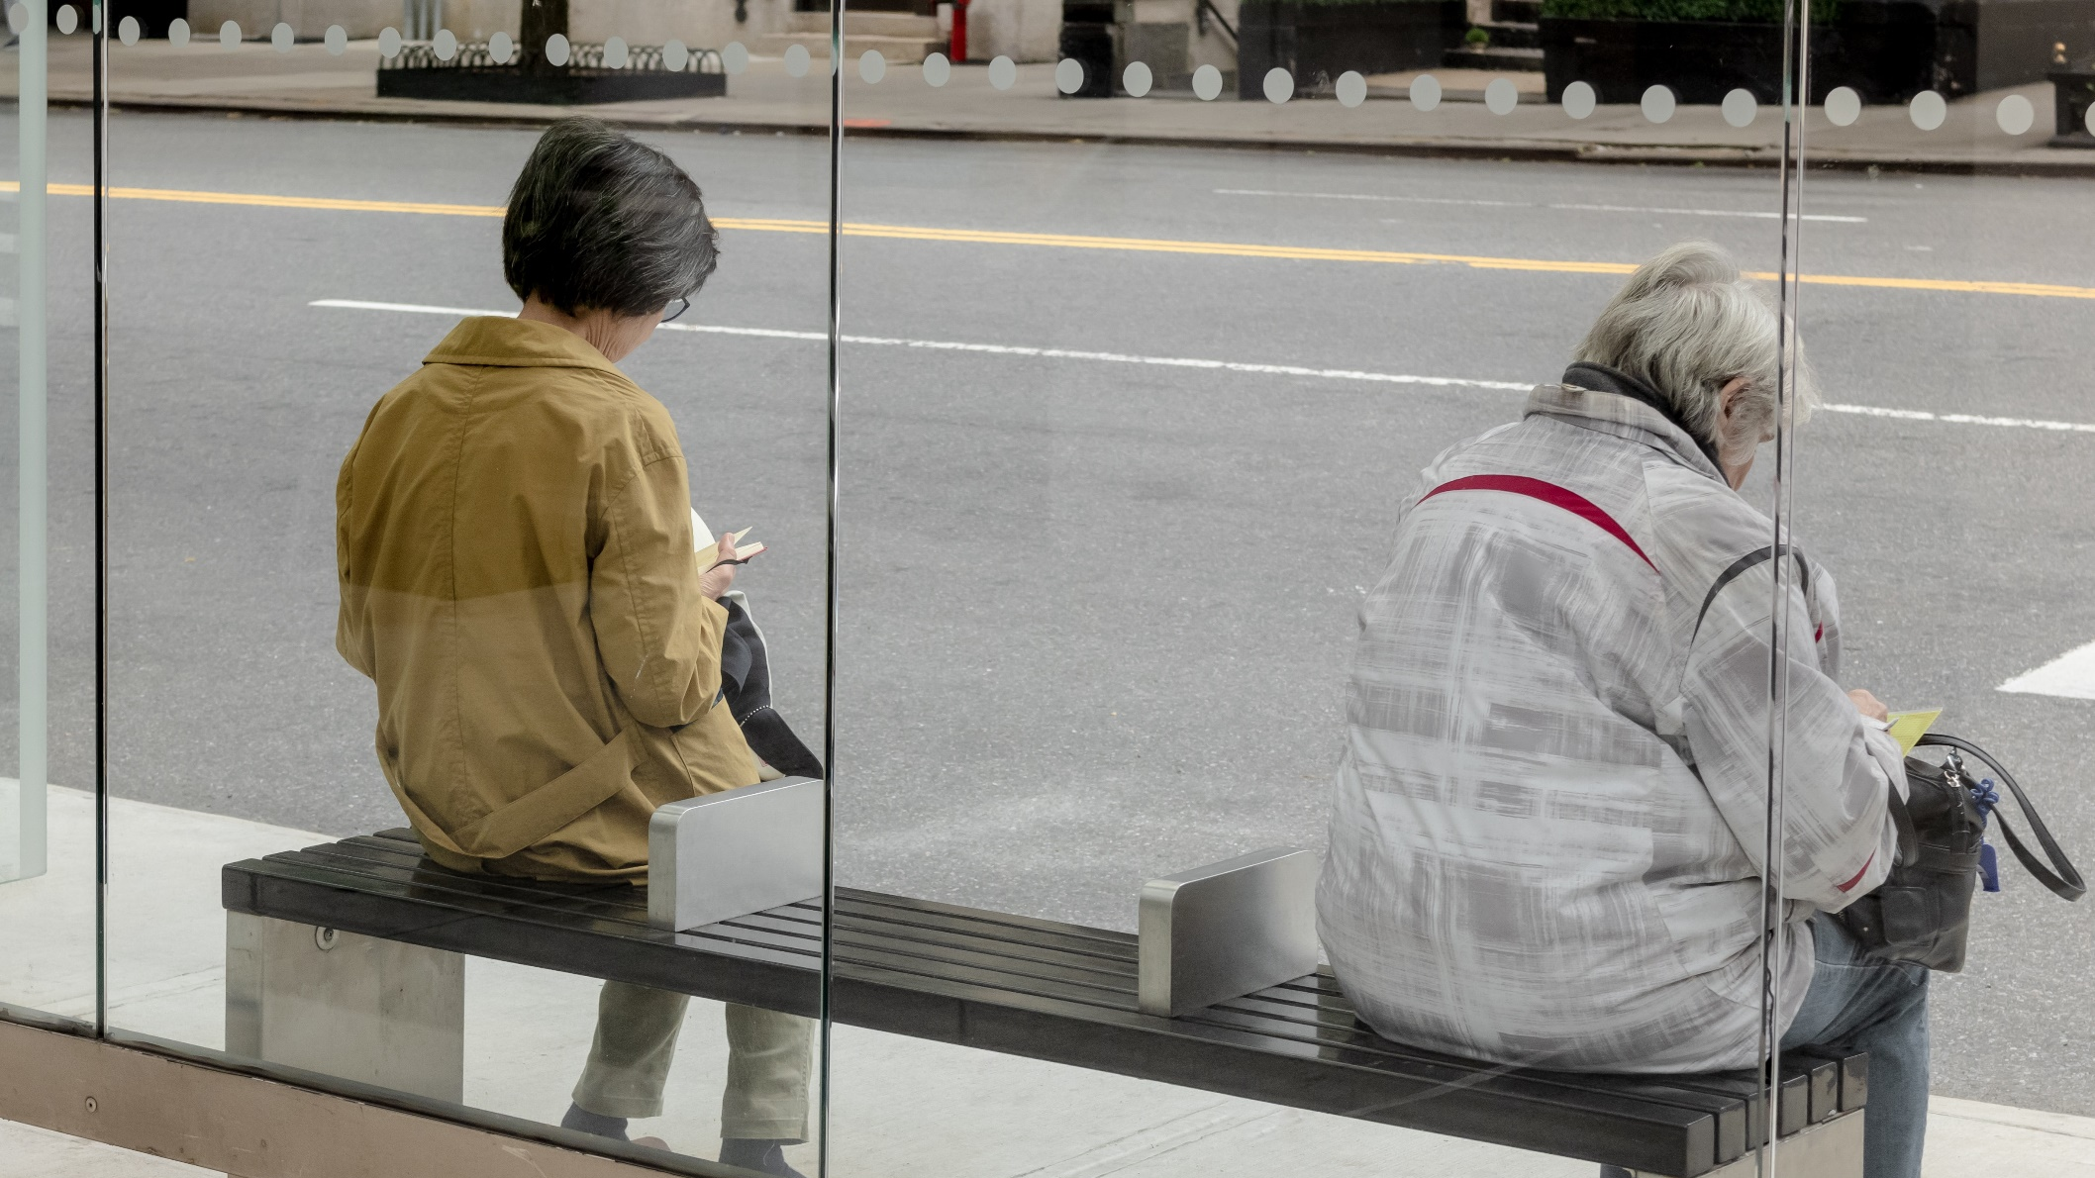
Did stringency measures influence happiness across the world over the course of the pandemic? Benjamin Strusch, Nils Müller, Svea Graupner
Photo by the blowup

Slide 2
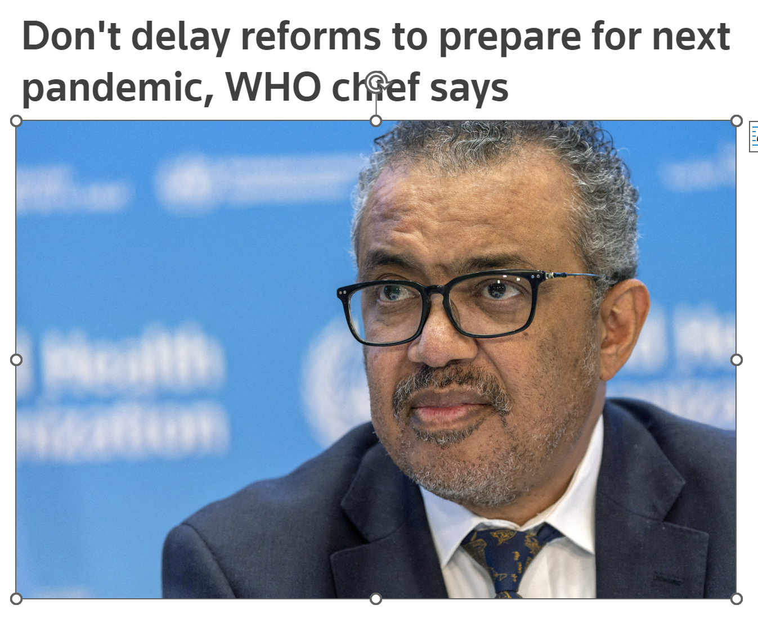


Did stringency influence happiness across the world over the course of the pandemic?

Slide 3
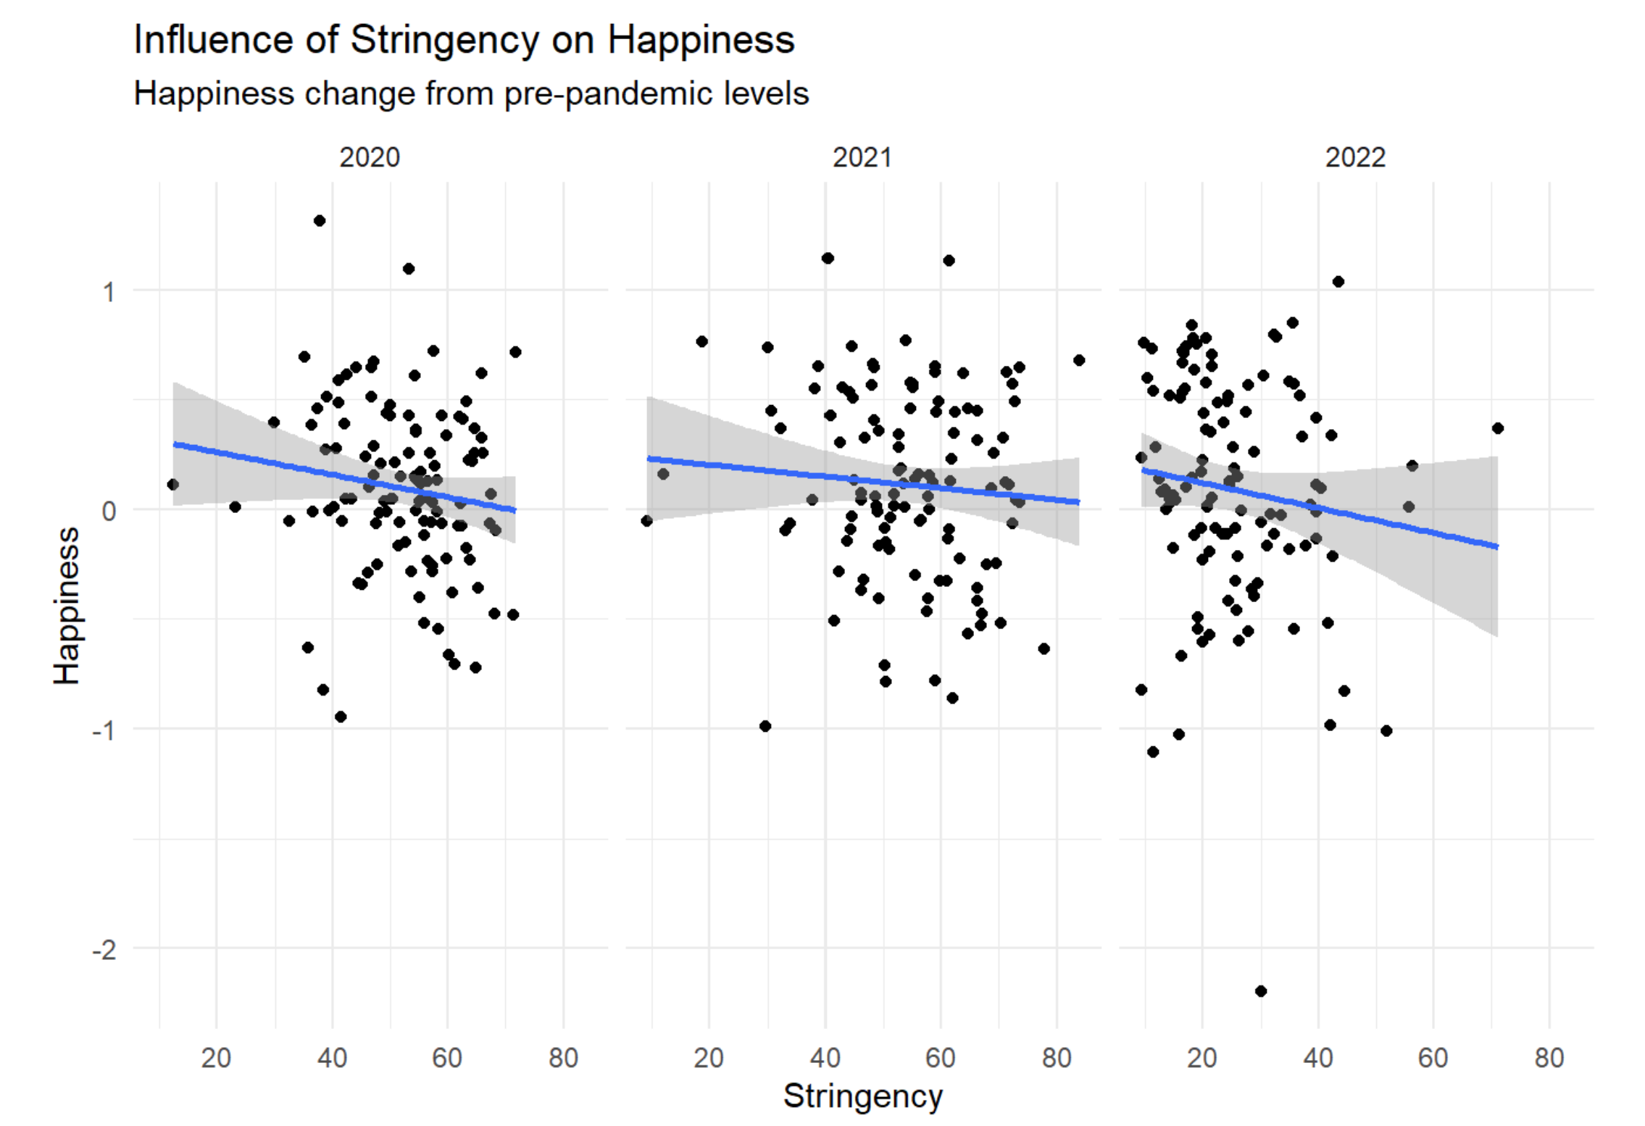

Slide 4



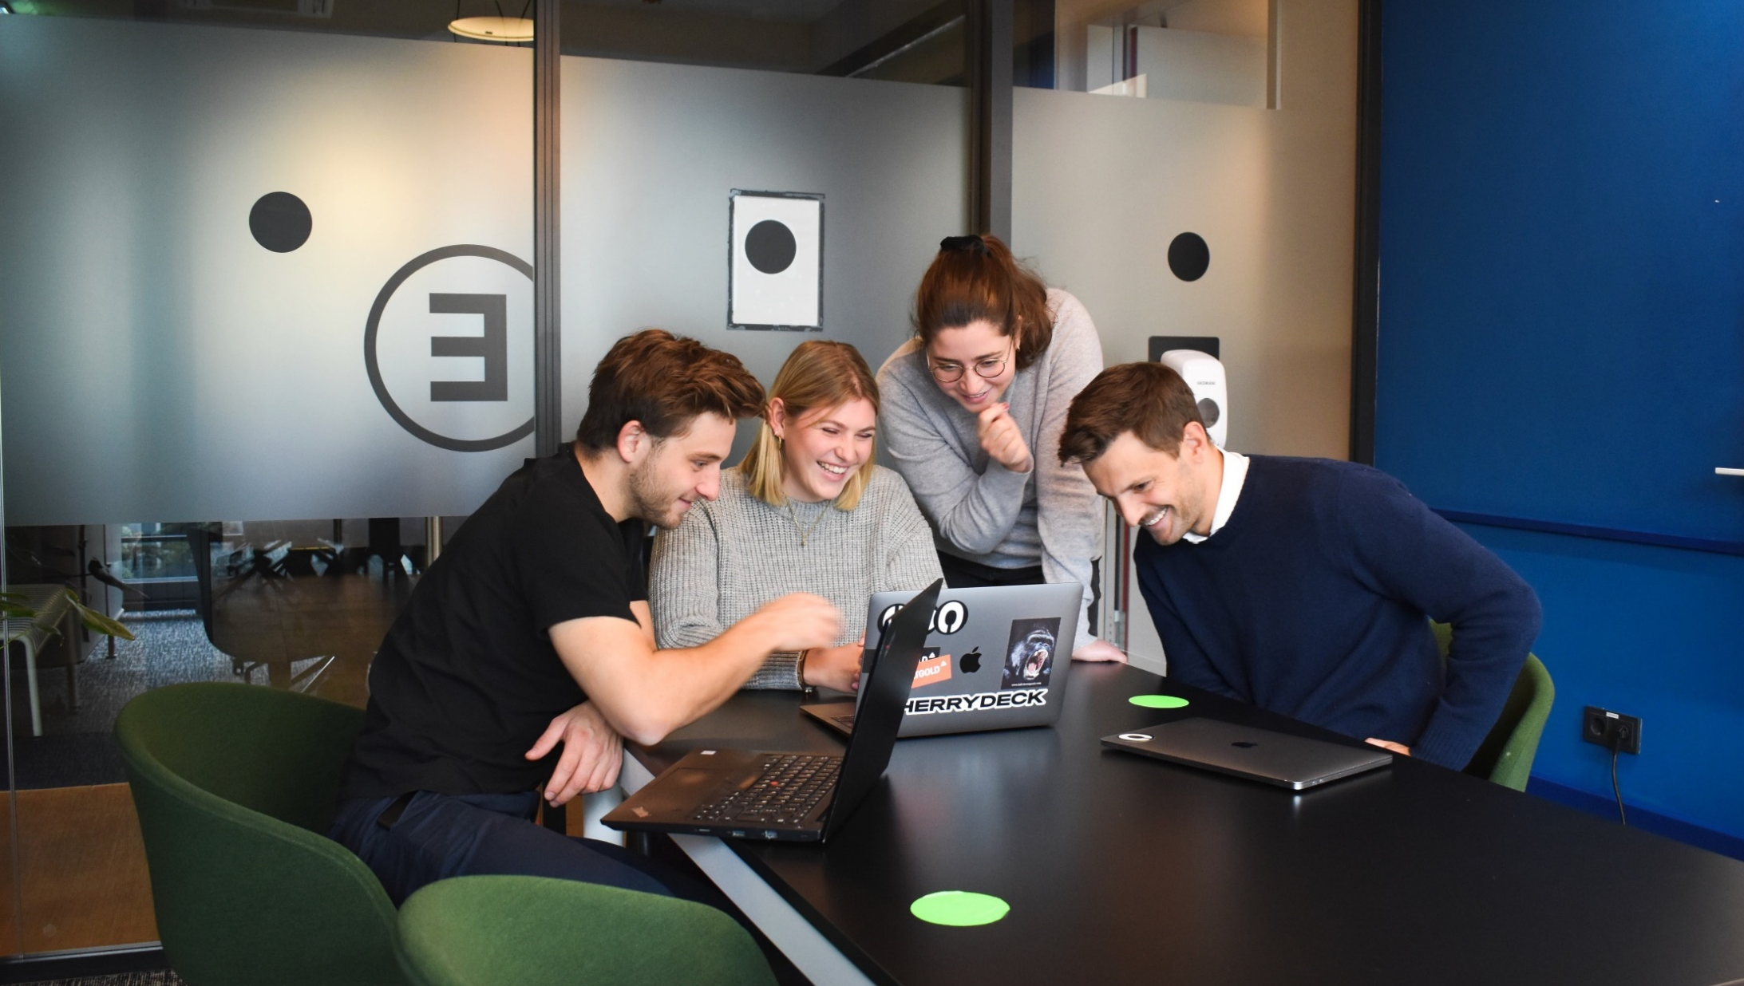
Photo by Markus Spiske
Photo by Olav Ahrens Rotne
Photo by Wolfgang Rottmann
Photo by cherrydeck

Slide 5



Photo by Júnior Ferreira
Photo by Shyam
Photo by Irham Setyaki

Slide 6

Thank you!

